Slide 1
K.Kleidis & N.K.Spyrou
A Conventional Form
of
Dark Energy
kleidis@astro.auth.gr

Slide 2
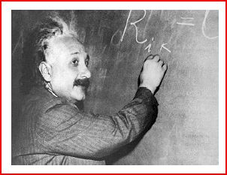
THEORY
Albert Einstein (1916) General Theory of Relativity
Geometry: Robertson – Walker line-element (1934)
S(t): Scale Factor : Determines the evolution of the curvature radius of the spatial
“slices”, in time.

Slide 3
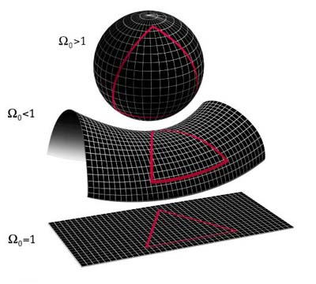
k : curvature parameter
+1 closed spatial sections
k = -1 open spatial sections
0 flat spatial sections

Slide 4
Matter – energy content Perfect Fluid
ε : total energy-density
p : pressure
u^{μ}: four–velocity (μ = 0, 1, 2, 3)
Conservation law:
hydrodynamic flows of
the volume elements
continuity equation

Slide 5
During the early 30΄s:
The Universe matter–content was thought to consist ONLY of what we were able to “see”!
ε = ρ c ²
ρ: the rest–mass density of the ordinary (baryonic) matter.
The Universe matter-content appeared to be “collisionless”.
Continuity equation: Evolution of the rest–mass density.

Slide 6
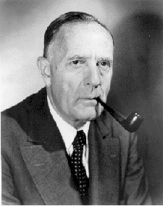
Albert Einstein (1917)
“The Universe is both static and closed!”
To avoid mathematical disaster, he decided to “correct” the field equations, introducing
the cosmological constant, Λ.
Λ – term: A constant energy – density.
In the Newtonian limit introduces a repulsive gravitational force!
Edwin Hubble (1929) : “The Universe expands!”
Hubble parameter:
Hubble’ s law: υ = H₀ r H₀ = 70.5 ± 1.3 (km/sec)/Mpc (Komatsu et al. 2009 )

Slide 7
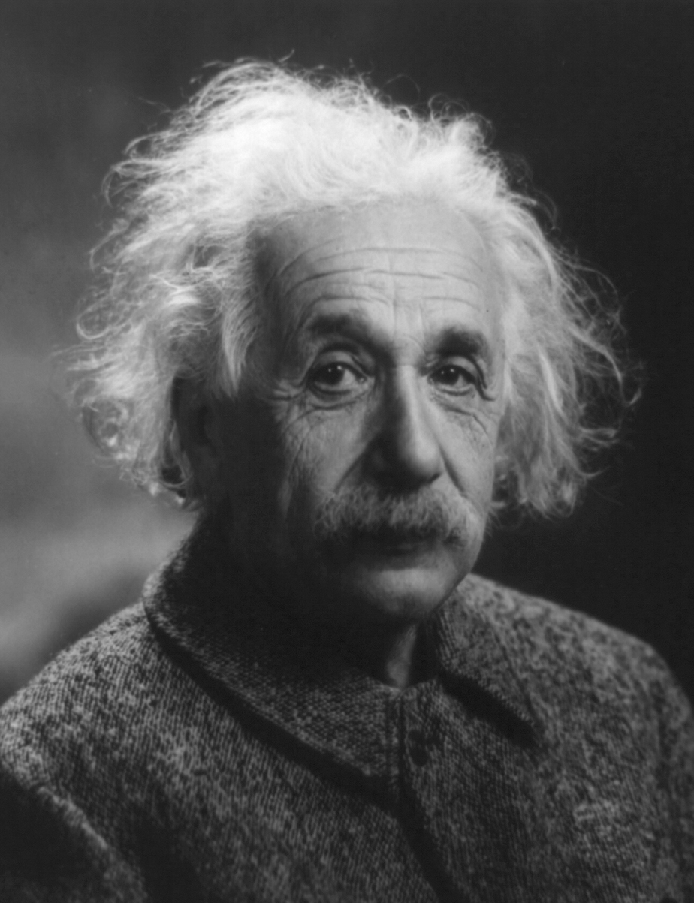
Albert Einstein (1934)
“…The introduction of Λ was
the biggest blunder of my life!...”
Or (maybe) not?

Slide 8
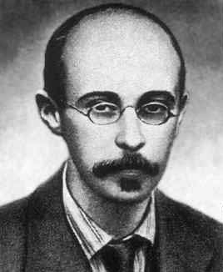
The evolving Universe
Alexander Friedmann (1922)
For k = 0 (flat model) : critical rest–mass density

Slide 9
Introducing the cosmological red shift parameter :
the “horizon” length
the density parameter

Slide 10
At the present epoch : S = S₀ , z = 0 , H = H₀
Closed model (k = +1) : Ω₀ > 1
Open model (k = - 1) : Ω₀ < 1
Flat model (k = 0 ) : Ω₀ = 1

Slide 11
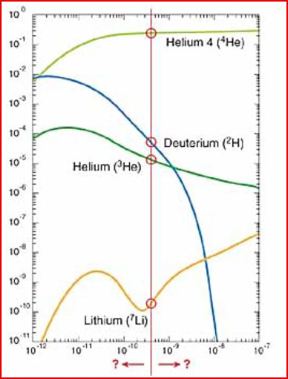
OBSERVATIONS
5 – year WMAP data (Komatsu et al. 2009) : ρ_{c} ≈ 1.04 x 10⁻²⁹ gr/cm³
Ordinary (baryonic) matter:
Light chemicals’ abundances
suggest that (Olive et al. 2000)
Dark Matter (DM):
F. Zwicky (1933) : Stability of large – scale structures!
V. Rubin (1970): Confirmed in the case
of our Galaxy!

Slide 12
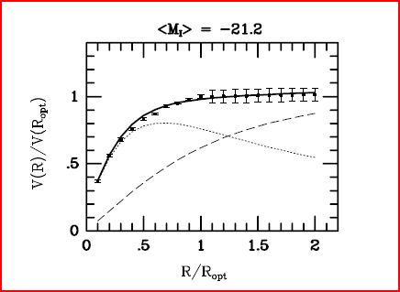
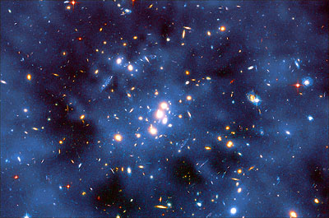
Today :
Galactic rotation curves.
Weak gravitational lensing
of distant galaxies.
Weak modulation of strong
lensing around massive el-
liptical galaxies.
X-ray emission on the scale
of galaxy clusters.
DM is assumed to consist of non-relativistic WIMPs (Cold Dark Matter – CDM), which are thought to be collisionless(?)
More than 80% (by mass) in the
Universe consists of non–luminous
(and non–baryonic) material !

Slide 13
This amount contributes to the total rest–mass density of the Universe an additional 23% of ρ_{c} .
Hence:
Conclusion : We live in an open FRW model!

Slide 14
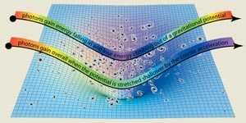
Probing the Cosmic Microwave Background (CMB)
Yakov B. Zel’dovich (1970)
Energetics of the CMB photons as they fall
in and climb out of the potential wells of
the already evolved density perturbations,
suggest that:
Deep potential well => considerable energy–loss => Cold spot
Shallow potential well => not too much energy–loss => Hot spot

Slide 15
Angular size of the spots
k > 0 Δθ > 1⁰
k = 0 Δθ ≈ 1⁰
k < 0 Δθ < 1⁰

Slide 16
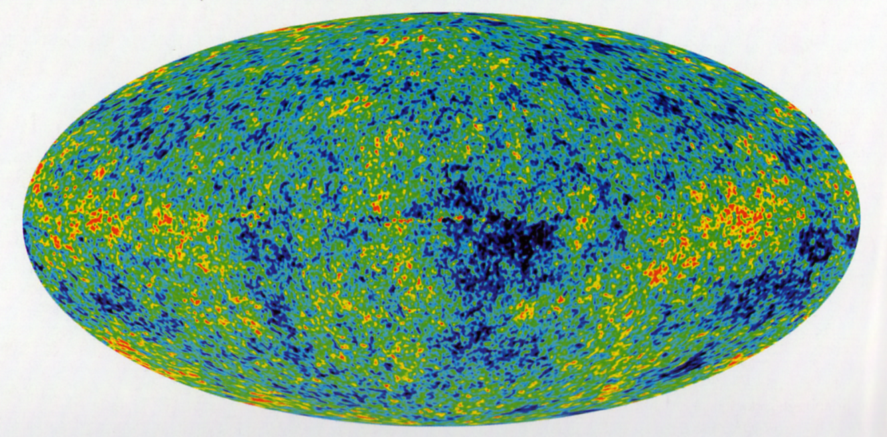
(1999) MAXIMA – BOOMERanG Provided strong evidence that Δθ ≈ 1⁰
(2003-08) Wilkinson Microwave Anisotropy Probe (WMAP)
Confirmed, beyond any doubt, that, we do live in a spatially–flat FRW model!
In other words, … today, Ω₀ = 1.
Since Ω_{M} = 0.27 < 1, we conclude that :
The Universe should contain a considerably larger amount of energy than the equivalent to the total rest–mass density of its matter content does!

Slide 17
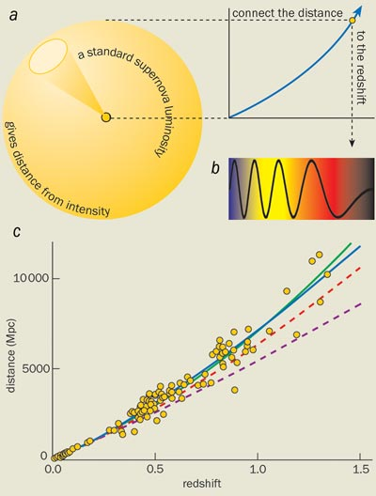
Now, it gets even better! For many years it has been a common belief that, the Universe decelerates its expansion, due to its own gravity.
Deceleration parameter :
In 1998 two scientific groups tried to determine the
value of q, using SNe Ia as standard candles
“SN Cosmology Project”
S. Perlmutter et al. 1999
“SN search team”
A. Riess et al. 1998
The idea was to measure the red shift (z) and the apparent magnitude (m) of cosmologically–distant indicators (standard candles) whose absolute
magnitude (M) is assumed to be known.

Slide 18
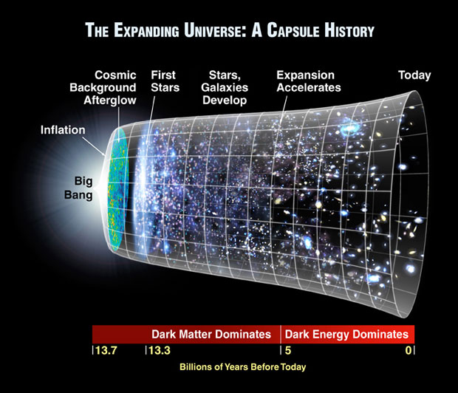
The corresponding results should have been arranged along the (theoretically predicted) curve of the:
Distance Modulus
where d_{L}(z) is the luminosity distance in an open (as they used to assume) FRW model.
Surprisingly:
The SN Ia events, at peak luminosity, appear to be dimmer, i.e., they seem to lie farther than expected!
A possible explanation:
Recently, the Universe accelerated its expansion!
Moreover:
The best fit to the observational data was given by
(Carroll et al. 1992)
Corresponding to a spatially–flat FRW model with

Slide 19
The cosmological constant strikes back!
The particle–physics’ vacuum contributes an effective cosmological constant (repulsive in nature) and, therefore, it could justify for both the spatial flatness and the accelerated expansion of the Universe.
Unfortunately, it is 10¹²³ times larger than what is observed!
But, if not Λ, then what?
Cosmologists came up with a name that reflects our ignorance on the nature of the most abundant Universe constituent:
The Dark Energy!

Slide 20
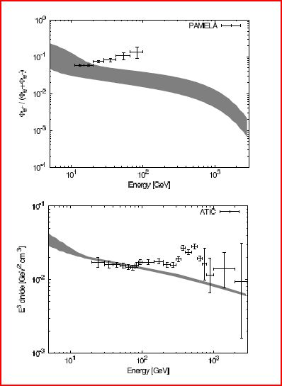
Candidates for the dark energy:
Cosmological constant p = - ρ c²
Quintessence - ρ c² < p < 0
Other (more exotic) scalar fields p < - ρ c²
Are there any conventional candidates ?
A convenient one would be the Interacting Dark
Matter (Spergel & Steinhardt 2000)
Indeed, recent results from high–energy–particle’s
tracers revealed an unusually–high electron –
positron production in the Universe.
Among the best candidates for such high–energy events are the annihilations of WIMPs, i.e.:
The DM constituents can be slightly collisional.
(see, e.g., Arkani–Hamed et al. 2009, Cirelli et al. 2009, Cohen & Zurek 2010)

Slide 21
Our model
Motivated by there results, we have considered a more conventional approach to the dark energy concept.
If the DM constituents interact with each other frequently enough, so that their (kinetic) energy is re-distributed, i.e., the DM itself possesses, also, some sort of thermodynamical properties, a conventional extra energy component does exist in the Universe:
It is the energy of the internal motions of the collisional–DM fluid!
Based on such an assumption:

Slide 22
We study the evolution and the dynamical characteristics of a
spatially–flat cosmological model
in which (in principle) there is no DE at all !
The matter–energy content consists of : (i) DM (dominant)
(ii) Baryonic matter (subdominant)
These two constituents form a gravitating perfect fluid of positive pressure
p = w ρ c² , where 0 ≤ w = (c_{s}/c)² ≤ 1
the volume elements of which perform adiabatic flows.
Together with all the other physical characteristics, the energy of this fluid’ s internal
motions is (also) taken into account, as a source of the universal gravitational field.

Slide 23
The total energy – density is given by
Π : internal energy per unit mass (energy within a specific volume)
Cosmological Evolution
The first law of thermodynamics for adiabatic flows yields:
The continuity equation results in:
The Friedmann equation (for k = 0) with Λ = 0 :

Slide 24
At the present epoch, where S = S₀ & H = H₀ :
Therefore:
In principle, the extra (dark) energy, needed to flatten the Universe, can
be compensated by the energy of the internal motions of a collisional–
DM fluid!

Slide 25
In this case:
can be solved in terms of the error function .
For
a natural generalization of the E-dS model (S ~ η² ).
The Hubble parameter (in terms of z):
it is functionally similar to the corresponding result regarding a DE fluid.
However, in our model w ≥ 0.
On the approach to z = 0, Η(z) decreases !

Slide 26
Deceleration parameter:
A cosmological model filled with collisional–DM
necessarily decelerates its expansion!
This model is inadequate for confronting the apparent accelerated expansion!
In fact, it does not have to!

Slide 27
Mistreating DM as collisionless
We distinguish two kinds of observers, based on their perception about the Cosmos :
Those who treat the DM as collisional
Accordingly, the various motions in this model are (in principle) hydrodynamic
flows of the volume elements of the collisional-DM fluid.
Those who insist in adopting the collisionless–DM approach
As far as these observers are concerned, the various motions in the Universe (necessarily) take place along geodesic trajectories of test particles receding from each other.
These two models (describing the same Universe) can be related by a conformal
transformation (Kleidis & Spyrou 2000):

Slide 28
Upon consideration of isentropic flows, the conformal factor is given by
In terms of z, takes on the functional from
We can express several cosmologically–significant parameters of the collisional–DM model (un-tilde variables) in terms of the traditional, collisionless–DM approach (tilde variables).
The cosmological red shift:
At relatively–low values of z (z < 5 ) :
For every fixed value of z the corresponding collisionless–DM quantity is a little bit
smaller .

Slide 29
The luminosity distance:
As long as w ≠ 0 , , for every z > 0.
The corresponding distance modulus :
From the point of view of an observer who adopts the collisionless–DM scenario any light–emitting source of the collisional–DM Universe (w ≠ 0) appears to be dimmer than expected, i.e.,
Comparison with the SN Ia data:
An extended sample of 192 SN Ia events used by Davis et al. (2007), consisting of
45 nearby events
57 events from SNLS (Astier et al. 2006)
60 events from ESSENCE (Wood – Vasey et al. 2007)
30 events from Gold-07 (Riess et al.2007)
http://www.ctio.noao.edu/essence
http://braeburn.pha.jhu.edu/~ariess/R06

Slide 30
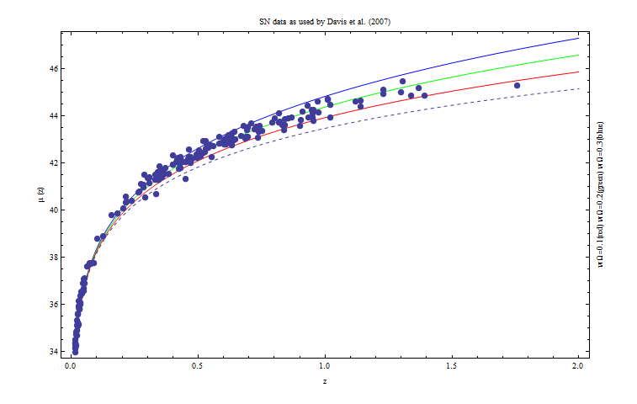
So … what’s the catch in it ?
w Ω_{M} = 0.1 => w = 1/3 The DM consists of relativistic particles!
w Ω_{M} = 0.2 => w = 2/3 The best fit is achieved for w ≈ 2/3 (?)
w Ω_{M} = 0.3 => w = 1 The DM consists of stiff matter !

Slide 31
The Hubble parameter:
The deceleration parameter:
The condition for accelerated expansion is:

Slide 32
If the Universe matter–content consists of a collisional–DM fluid with
w > w_{c} = 0.238
so that:
then, from the point of view of someone who treats the DM as collisionless, there exists a transition value (z_{t} ) of the cosmological red shift, below which the Universe is accelerating!
Adopting the observational result
z_{t} = 0.46 ± 0.13 (Riess et al. 2004)
we arrive at
wΩ_{M} = 0.106 ± 0.012.
Once again
w ≈ 1/3
i.e., the DM – fluid consists of relativistic particles (Hot Dark Matter ?)

Slide 33
SUMMARIZING
We have considered a cosmological (toy) model, i.e., not necessarily reflecting our own Universe, in which:
The DM constitutes a fluid of relativistic particles
Interacting with each other frequently enough, thus attributing to this fluid some sort
of thermodynamical properties.
This model:
Could provide a conventional explanation for the extra (dark) energy needed to flatten the Universe:
It can be compensated by the energy of the internal motions of the collisional–DM fluid.
(ii) Could account for the observed dimming of the distant light–emitting sources:
It can be due to the misinterpretation of several cosmologically–relevant parameters by an observer who (although living in a collisional–DM model) insists in adopting the (traditional) collisionless–DM approach.

Slide 34
Could explain the apparent accelerated expansion of the Universe without suffering
from the coincidence problem.
Although speculative,
the idea that the DE could be attributed to the
internal physical characteristics of a collisional–DM fluid
is (at least) intriguing
and should be further explored and scrutinized
in the search for
conventional alternatives to the DE concept !

Slide 35
THANK YOU
FOR
YOUR ATTENTION!

